Slide 1
Hybrid Graphical User Authentication by Mesh of Matrix
Salim Istyaq
University Polytechnic, Faculty of Engineering & Technology, AMU, Aligarh, U.P., India
saleemishtiyak@gmail.com
Mohammad Sarosh Umar
Department of Computer Engineering, Faculty of Engineering & Technology, AMU, Aligarh, U.P., India saroshumar@zhcet.ac.in

Slide 2
INTRODUCTION
Textual password is the most common password used for authentication. The disadvantages of these methods are the system is prone to dictionary attack, shoulder surfing, social engineering etc. The concept of using long password is also good but there are many problems i.e. these are not easy to remember due to their complexity. Study shows that the user tends to choose their password which is short and friendly to remember. So we move on to the new concepts i.e. graphical passwords and biometrics. But these techniques are also have their own barriers, e.g. in biometric like iris scan, retina scan, finger print etc. The cost of establishment is too much high compare to the others security modules and authentication process is too much slow. Huge numbers of techniques are coming day by day. From last decade most of those were suffered from vulnerabilities like shoulder surfing .There are graphical passwords scheme that have been proposed which are resistant to shoulder surfing. But have own disadvantages like usability issue or taking more time for login or having tolerance level. In this paper, we introduced a system which has very rare chance of all the cracking possibilities. We provided very deep complexity to our system for unknown user and only the legal user knows the combination of lines and sequence of their selection.

Slide 3
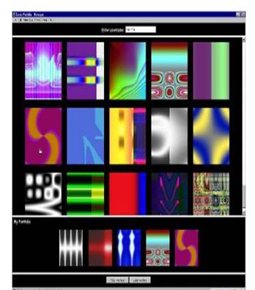
RELATED WORK
1. Dhamija and Perrig proposed a graphical authentication system based on the hash visualization technique. In this authentication system the user has to select the images from the set of random images. To authenticate in the system, he or she asked to select the preselected image as selected earlier in the registration phase. The weakness of the system is that the server needs to store the seeds of the selected image of each and every user in the simple or plain text.
Fig. 1 Random images used by Dhamija and Perrig

Slide 4
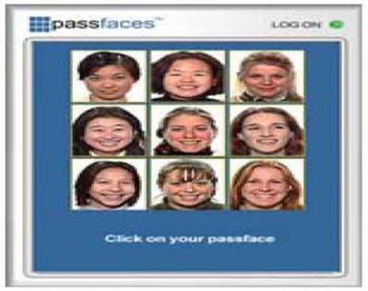
2. Pass face is supported by the fact that the human brain can quickly recognize the face. It is a technique in which a user has to select the faces from the grid. The user is asked to select the images for given period of time.
Fig. 2 Pass faces

Slide 5
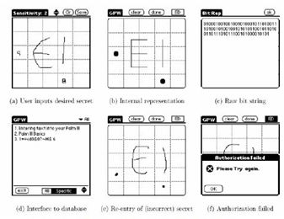
3. Jermyn et al., proposed a new technique on which user has to draw a secret i.e. DAS on a given 2D grid. If the drawing matches on the same grid in same sequence then the user is authenticated on the basis of their selection.
Fig. 3 DAS technique by Jermyn

Slide 6
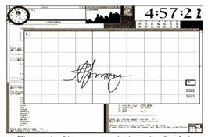
4. Syukri proposed a system in which the user has to draw the signature using the mouse. It includes registration and verification phases. At the time of registration, the user draws a signature on an area through which it has to be saved on the database and at the time of verification this signature is extracted from the database.
Fig. 4 Signature technique by Syukri

Slide 7
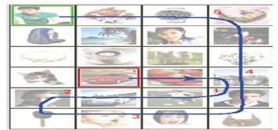
5.Haichang et el., proposed a new shoulder surfing resistant scheme as shown in Fig. 5, where the user is required to draw a curve. This graphical scheme is the combination of DAS and story scheme that provide the user great authenticity.
Fig. 5 Haichang’s shoulder-surfing technique

Slide 8
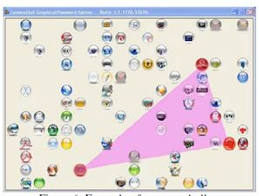
6. Wiedenback et al., proposed a system which is resistant to shoulder surfing on some extent. In this method, the user has to click the convex hull formed among the different objects in the search of passwords. The password length depends on area of solution; it acts as indistinguishable or hard to guess if the area of picture is more.
Fig. 6 Example of a convex hull

Slide 9
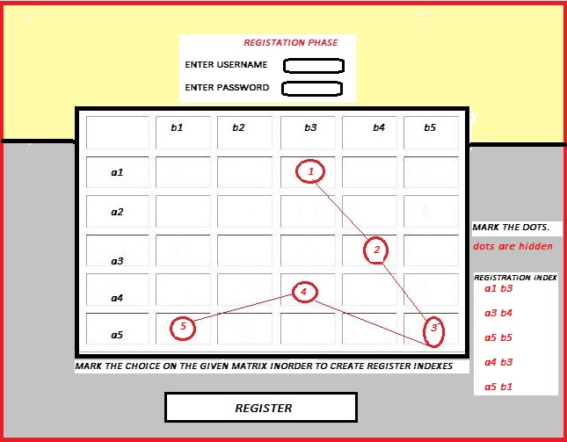
HYBRID AUTHENTICATION SCHEME
Registration Phase
In registration phase, the user first enters his username, the system checks whether the username exists or not in system. If it exists then the user has to choose another, if it does not then the user go further forward to choose their textual password. After choosing the textual password, the user has to click on some block of matrix on a blank matrix. When the user clicks on the matrix, the sequence of their selection is traced and saved to database as user presses the button to save as shown in Fig. 7. First user selects the username like (saleem) and password (1234), and then the user selects some block on a matrix. He selects the block (a1 b3), (a3 b4), (a5 b5), (a4 b3), (a5 b1). These selections are saved on the database after registration is successfully done. These act as a registration index.
Fig. 7 Registration Phase

Slide 10
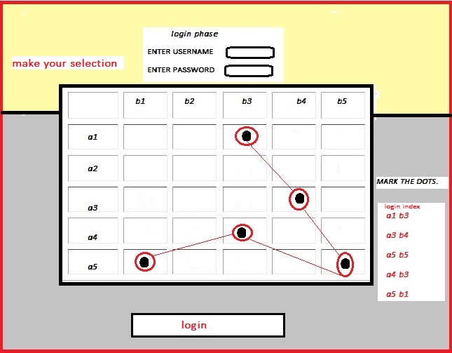
Login Phase
In login phase, the user enters his username and password. The system checks the username and password is matching correctly with the username and password in the database or not. If the given user id is correct then the user have a blank matrix in which he/she has to click on the block sequentially as he/she has done in registration phase. In Fig. 8, the user has to click the blocks as he/she selected in login phase i.e. (a1 b3), (a3 b4), (a5 b5), (a4 b3), (a5 b1), this will act as a login index.
Fig. 8 Login Phase

Slide 11
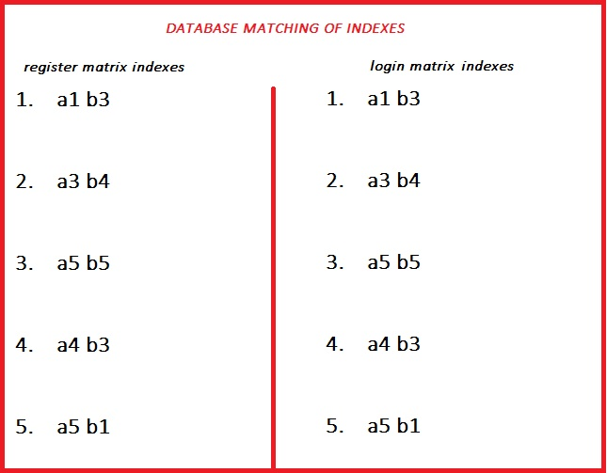
Verification Phase
In this phase, the system fetches the database first in order to match the login index with the registration index as shown in Fig. 9. If all the details are matched successfully then the user becomes able to login the system. The flowchart of proposed system is show in Fig. 10.
Fig. 9 Database matching of indexes

Slide 12
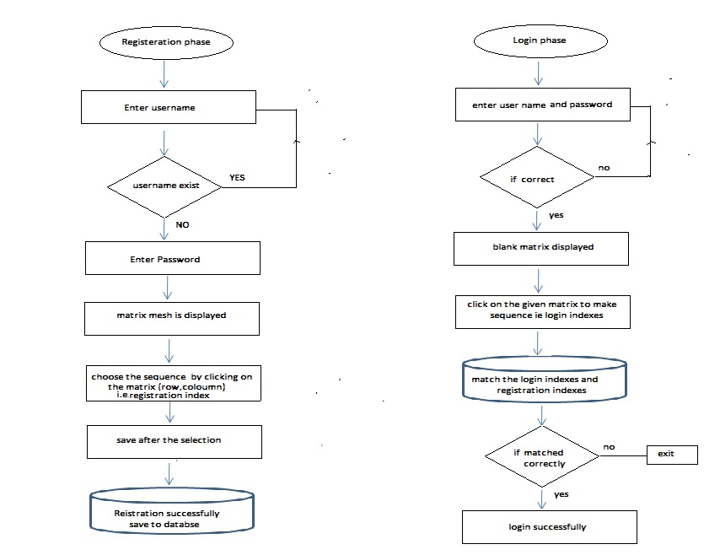
FLOWCHART
Fig. 10 Flowchart

Slide 13
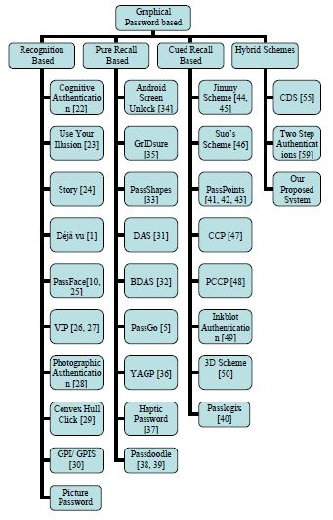
SECURITY AND USABILITY
The proposed system is hybrid and too much secure as you compare with the other authentication techniques, here it is too complex to the faulty user in order to pass through the different phases of system i.e. click on the correct grid and placed in a sequential manner to access OTP.

Slide 14
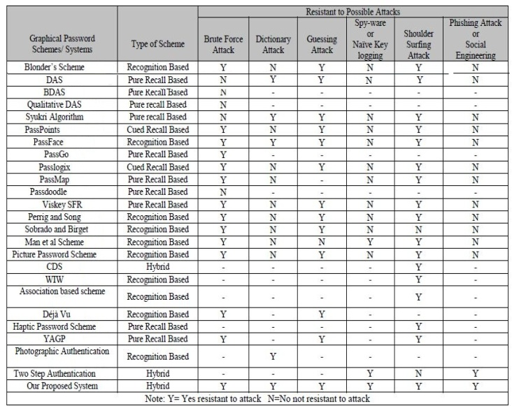
Our proposed system is too much secure as compared with others as shown in Fig. 12.
The possibilities of passwords generate in this system is very complex and depend on the indexes (positioning) and correct option of the matrix and finally a onetime password is to be send on the users phone.
Fig. 12 Compare of our system

Slide 15
CONCLUSION
In this paper we proposed a new way of authentication which is composed of both textual and graphical authentication schemes. The user one by one follows the schemes as he further able to login the system. The combination of this hybrid scheme will further provide a great protection from threatening attacks like shoulder surfing, brute force attack, dictionary attack etc. This concept of choosing the block in sequential manner from the mesh of matrix will create huge impact in authentication scheme in present and future. Through the medium of this paper, we now approach new way of authentication in coming future.

Slide 16
Thank You

